Slide 1
E-Government Development in Myanmar
Kay Khine Oo
Deputy Director
Ministry of Commerce
Myint Myint Lwin
Project Manager
Ministry of Science and Technology

Slide 2
Contents
General Information about Myanmar
History of e-Government Development in Myanmar
Current Status of e-Government in Myanmar
Challenges and Difficulties
Case Study
Moving forward

Slide 3


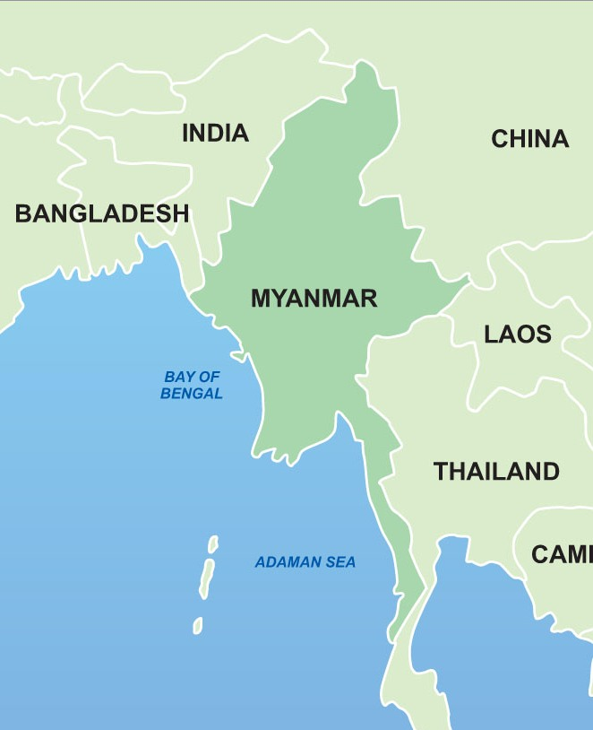

About Myanmar
Location: Southeast Asia
Area : 678,500 sq km (Land - 657,740 sq km
Water - 20,760 sq km)
Neighboring
Countries : Bangladesh, India, China, Laos and
Thailand
Capital: Nay Pyi Taw
Major Cities: Yangon, Mandalay
Population: 51.4 millions (2014 Census)
Ethnic Group: 135
Main ethnic
Groups: Kachin, Kayah, Kayin, Chin, Bamar, Mon,
Rakhine & Shan
Language: Myanmar (Burmese)
& ethnic groups have their own languages

Slide 4
History of E-Government Development in Myanmar
Initiated to transform e-government in 2002 to enhance the government services as well as improve its ranking in the global e-government.
1St ICT Master Plan ( 2002)
2nd ICT Master Plan ( 2006~2010)
3rd ICT Master Plan ( 2010~2016)
Common goal is to become Good Governance and Clean Government.
Building up the national portal in order to provide one stop online services to the citizens.

Slide 5

Current Status of E-Government Development in Myanmar
Development of Master Plan
E-Government Master Plan 2015 was initiated with support from the Asian
Development Bank (ADB).
Ranking Status
According to United Nations e-Government survey (2014), Myanmar’s ranking
is 175.
e-Government development index (EGDI) : 0.1869
Online service component : 0.0236
Mobile penetration rate
very important for allowing faster, easier and more
convenient use of available online resources
reaches half the country (about 54.6%)

Slide 6


Current Status of e-Government Development in Myanmar
Telecoms service providers
MPT(mobile phone market leader and )
Telenor of Norway
Oredoo of Quata
Objective is to provide coverage (data and voice services over 2G
& 3G network) to more than 90% of the population over the next five years.
Infrastructure development
Building Data Centers
Established Networks
Building telecommunication infrastructure
National backbone: Fiber Links
Cross border link: India, Thailand, China
International links are Sea-Me-We (3) Cable and Satellite
Last Mile Links: Dedicated Link, Wireless Broad Band Access, ADSL &
MPT Satellite Terminal

Slide 7

Current Status of e-Government Development in Myanmar
Human Resource Development
Many ICT professionals are graduated annually from Computer Universities under the jurisdiction of the Ministry of Science and Technology, Myanmar Computer Federation and private sectors.
However, the demand and supply of ICT professionals are still unbalanced.
Cooperation among ministries
Nowadays, many initiative meetings at ministry level
Establish own websites in each ministries

Slide 8
Challenges of e-Government Development in Myanmar
Inadequate network bandwidth
increases digital divide between rural and urban area
Lack of standard based approach
Still many difficulties for integration services
Inadequate skilled work force
Produces fewer graduated ICT professionals compared to neighboring countries such as India and China
Not interested in Government Services and contribution in e-Governance initiatives
Migration of skilled ICT workers to developed countries such as Singapore, Japan

Slide 9
Challenges of e-Government Development in Myanmar
Insufficient Budget Allocation for ICT
Lack of proper policies for the implementation stage
Low level of ICT literacy in citizens and government staffs
Most of the government processes are carried out manually and paper- based
Government departments need to be trained to use ICT and motivated to adopt the e-government processes
Lack of awareness of e-Government benefits
Low Level of telecommunication infrastructure
Telecommunication infrastructure index(TII) of Myanmar : 0.0084
Notes:
TTI of Least Developing Country: 0.0929.
TTI of Low Income country: 0.0876.
World average is 0.3650

Slide 10



e-Government development of MOST
MOST has been developing e-government projects since 2013 May for providing more efficient ministry management, improved interactions with teachers and students and deploying e-services at e-government development center under the MOST.
In order to achieve the target, MOST initiates the following e-government developments.
Building a MOST data center using Private Cloud Computing model to be rigid infrastructure.
Upgrading current ministry website to web portal
Certificate Verification System is implemented for students who are graduated from Computer Universities and Technological Universities.
Staff management system is developed for transforming the traditional way to e-service.

Slide 11


Case Study
Many e-government projects in Myanmar encounter different problems and fail to be implemented.
However, Staff Management System is successfully implemented and deployed in MOST.
This system is developed for the following reasons:
to get the updated staff information
to reduce the workloads and overhead cost of staff information processing for promotion, transfer, scholar, etc.
to allow staffs for checking and updating their information on time
Launched to all computer universities, technological universities, government technological colleges and schools.

Slide 12

SWOT Analysis

Slide 13

easy to collect staff information from the Ministry
save time consuming
provides paperless facilities
allows to download desired personal document from authorized users
S T R E N G T H S

Slide 14

low internet access
low ICT literacy in staff
hesitate to use the ICT and want to use the traditional methods
Internet usage is relatively expensive
WEAKNESSES

Slide 15
Moving forward
Still many steps to implement e-Government development
Need more cooperation and collaboration among relevant ministries
Support & technical assistance from International Organizations & other development partners

Slide 16


